Slide 1
Asymmetric copula in multivariate flood frequency analysis
Hannes Grün, Robin Schüttpelz

Slide 2
Relevance
Floods: Among most severe natural hazards worldwide
Multivariate flood analysis: Interdependence of flood event characteristics
Asymmetric copula functions: Varying strength of dependence between variables, allowing flexible modelling.

Slide 3
Dependence Structure
Relevant Variables: Flood peak (P), Duration (D), Volume (V).
Influences on Dependencies: P affects dependence structure between D & V
Relevant Influences: Portray multivariate dependencies in accurate manner

Slide 4
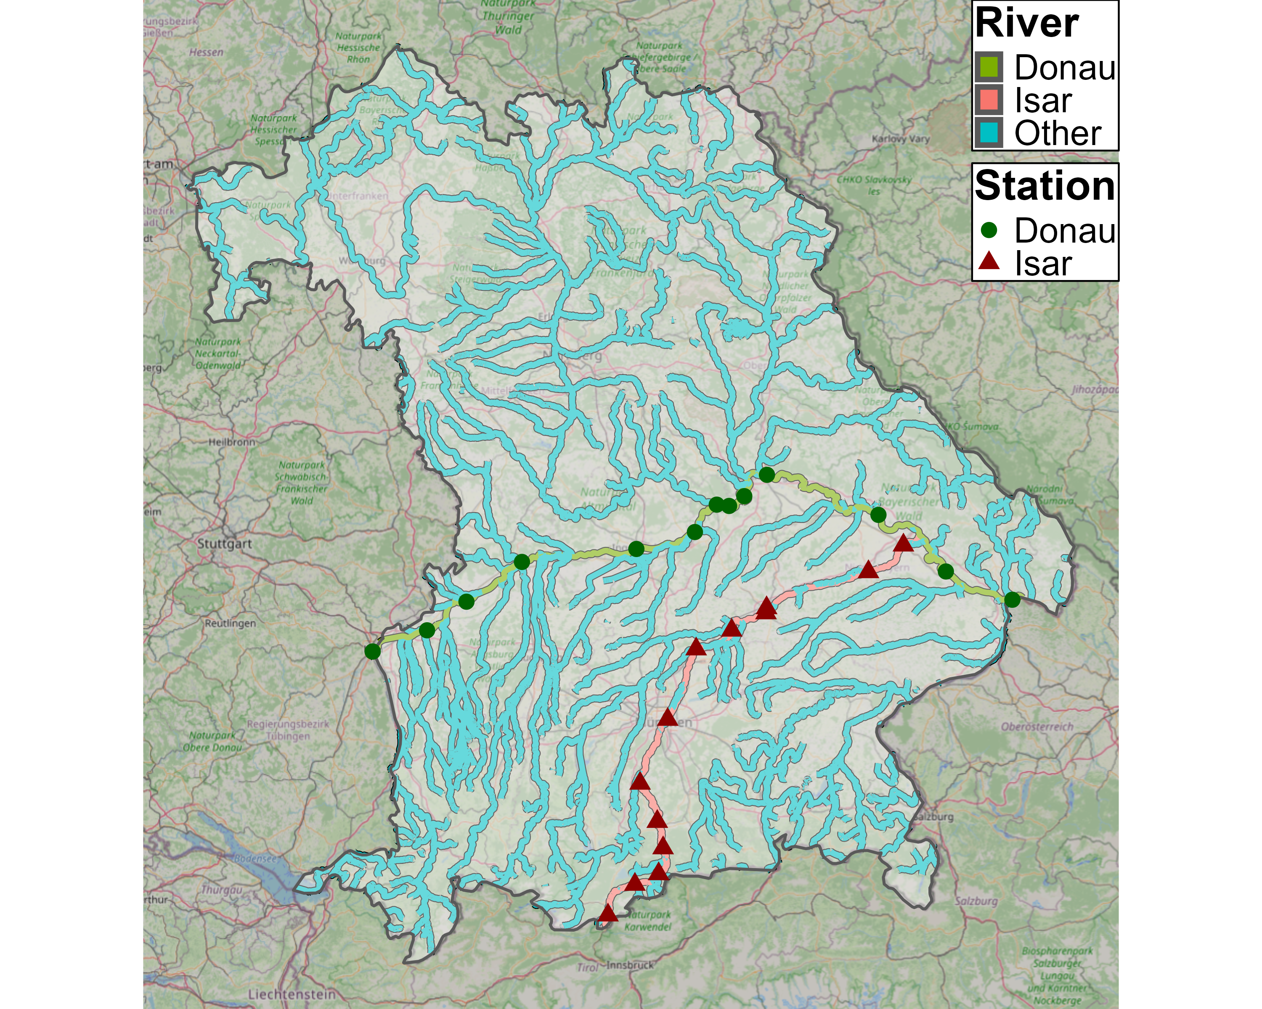
Data

Slide 5
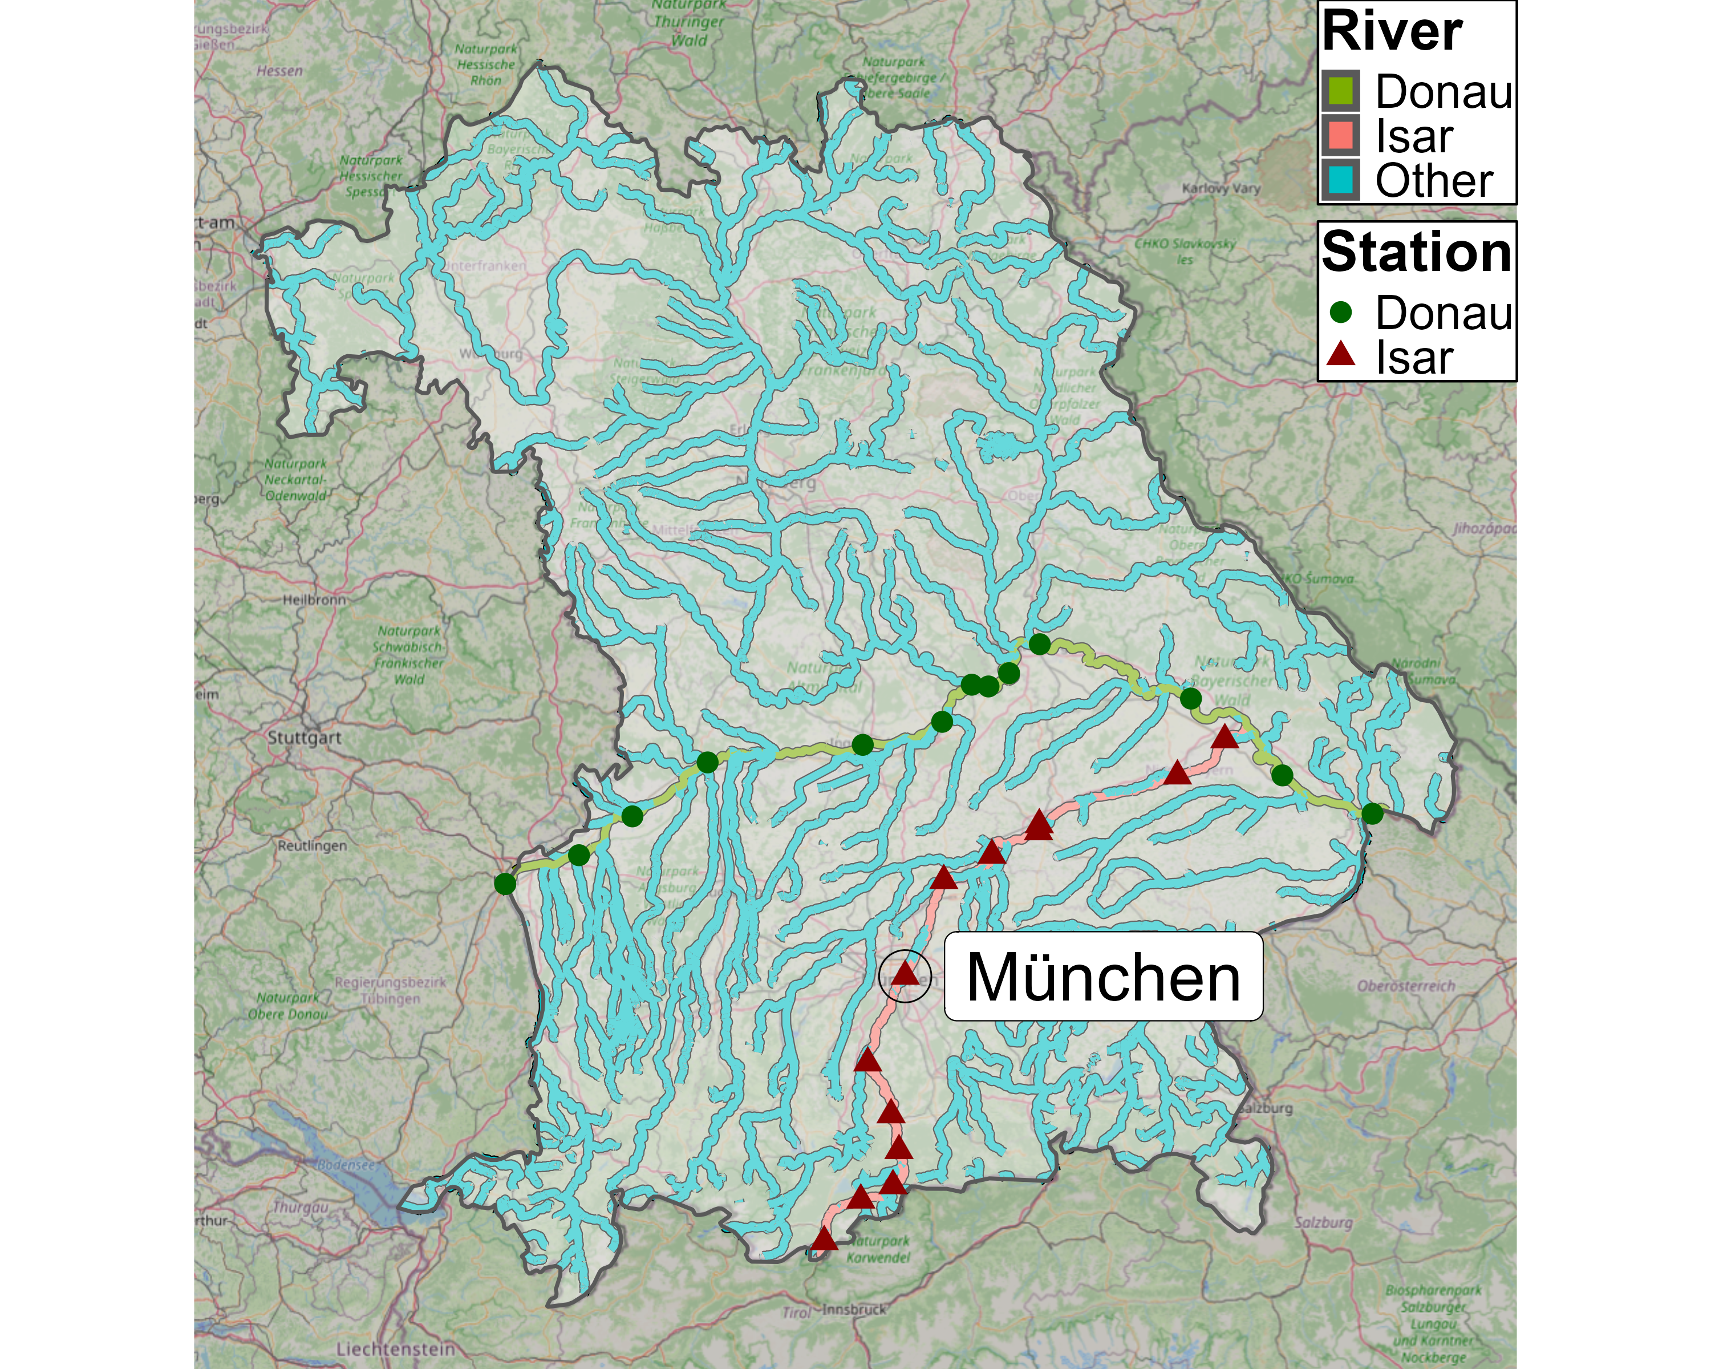
Data

Slide 6
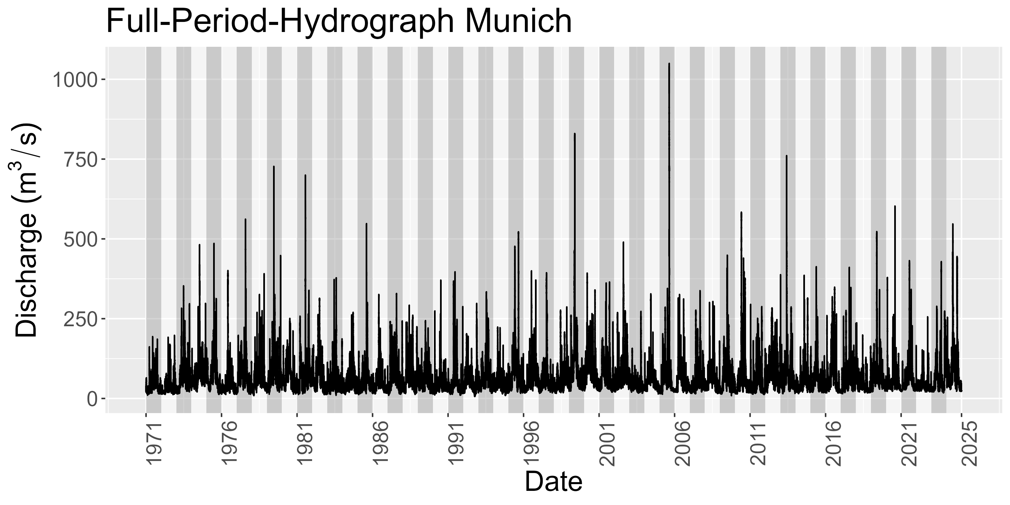
Data
Notes:
Hydrograph over 54 years
See later: number of years are number of observations per station

Slide 7
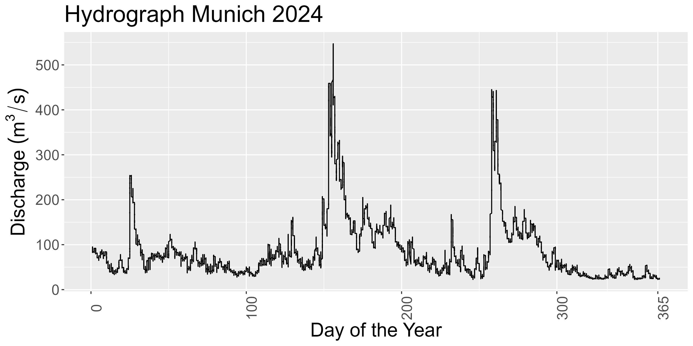
Data

Slide 8
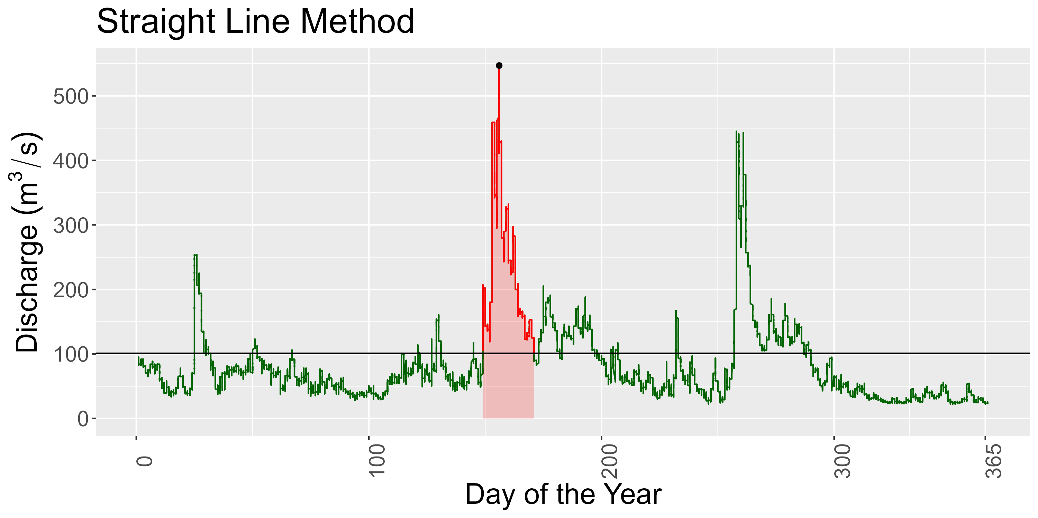
Data
Notes:
Contrary to the paper, we do not use fixed threshold
Reason: Fixed threshold is not reasonable IMO bc we are intersted in the dependence strucutre
Dependence structure / correlation is scale independent

Slide 9
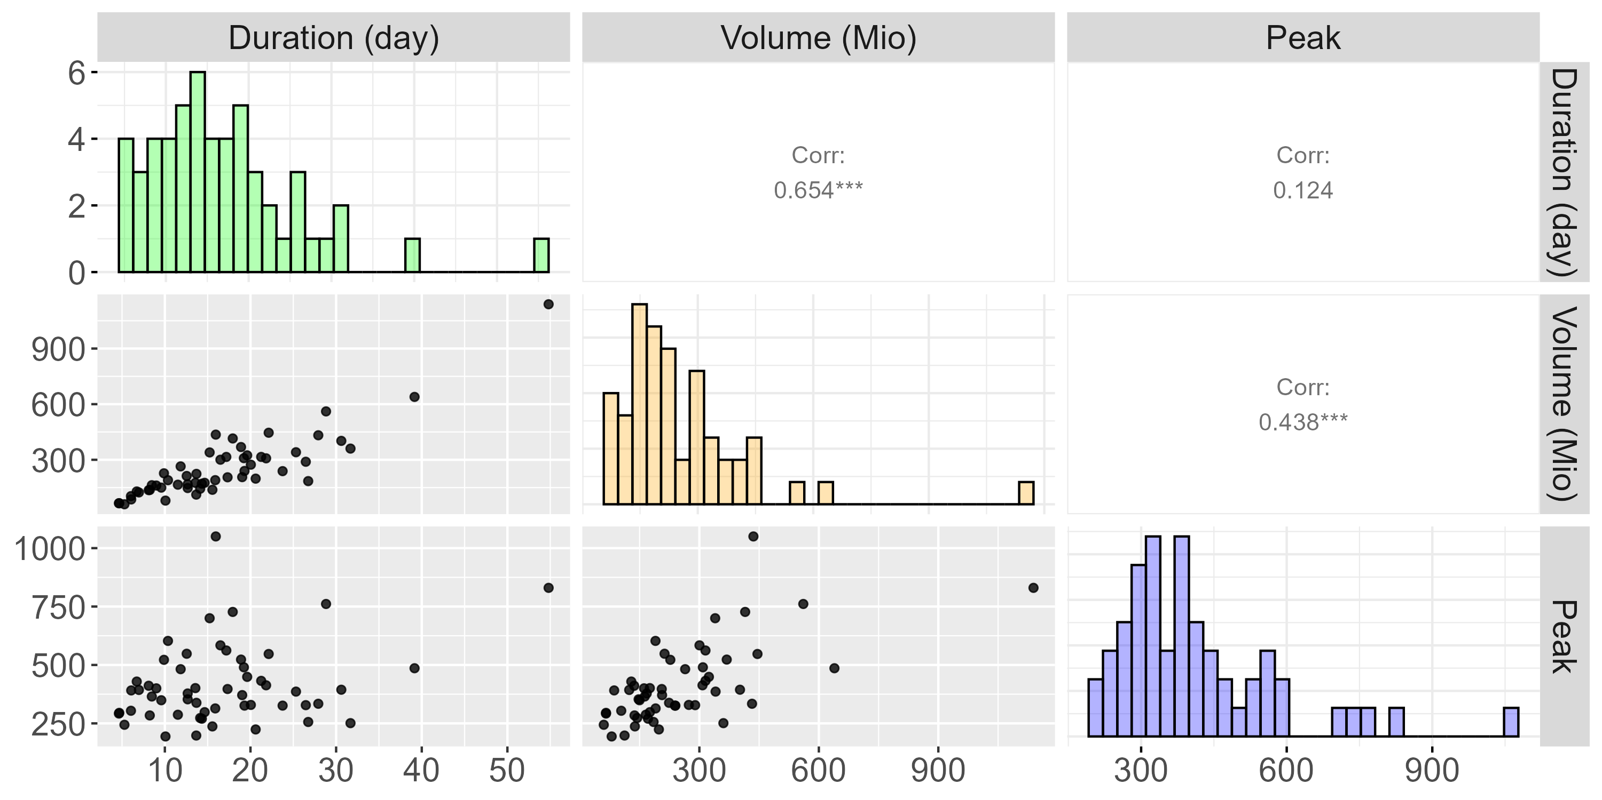
Data
Notes:
Do that for every year to obtain nobs = #years observations
This data used to fit station specific copula

Slide 10
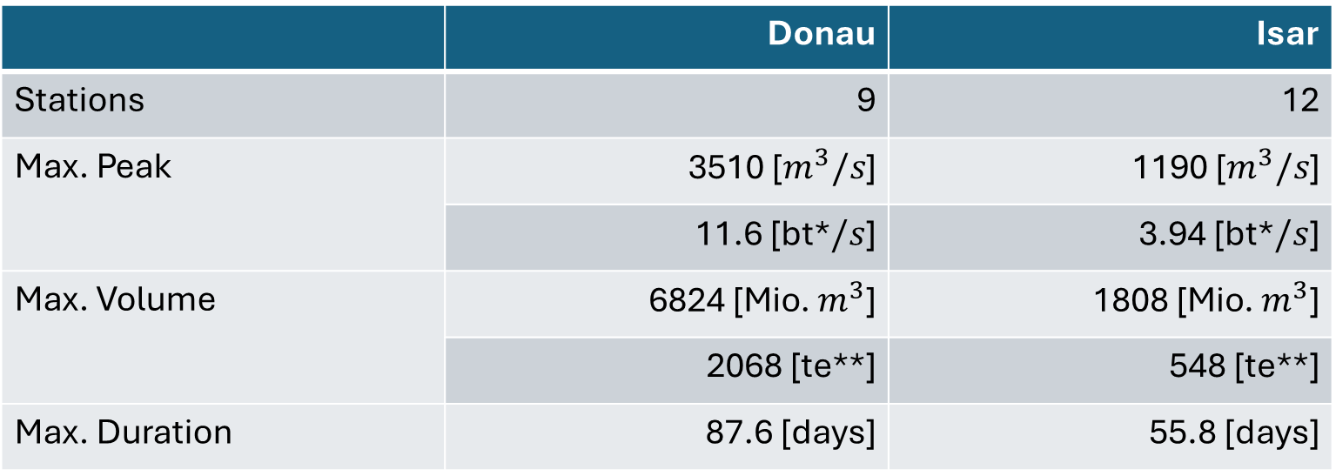
Data
 | Donau | Isar
Stations | 9 | 12
Max. Peak | 3510 [$m^{3}/s$] | 1190 [$m^{3}/s$]
 | 11.6 [bt*$/s$] | 3.94 [bt*$/s$]
Max. Volume | 6824 [Mio. $m^{3}$] | 1808 [Mio. $m^{3}$]
 | 2068 [te**] | 548 [te**]
Max. Duration | 87.6 [days] | 55.8 [days]
*bt denotes unit „bathtub“
**te denotes unit „Therme Erdingen“
Notes:
2 Rivers, 27 stations where: 6 have below 30 observations -> remove those bc pretty little infor for following methods
After removing: 2 Rivers, 21 stations: Donau: 9, Isar 12
Majority of stations have sample size of 54 with only 2 stations nobs between 44 and 50
In total, we have data on 1122 flood events
Largest observations by river:
Max peak in Donau: 3510 -> that is 11 Bathtubs/s
Max peak in Isar: ~4 bathtubs/s
Max vol in Donau: 6824 -> That is 2068 x Therme Erdingen (Flood took 46 days; in year 1988)
Max vol in Isar: 548 x Therme Erdingen (Flood took 48 days; in year 1999)
Max Duration Donau: 87 days
Max Duration in Isar: 56 days
Duration Reminder: A river is flooded as long as its discharge is above ist 75% quantile;
i.e. It took 87 bzw. 56 days for the discharge to drop below the 75% quantile within that year

Slide 11
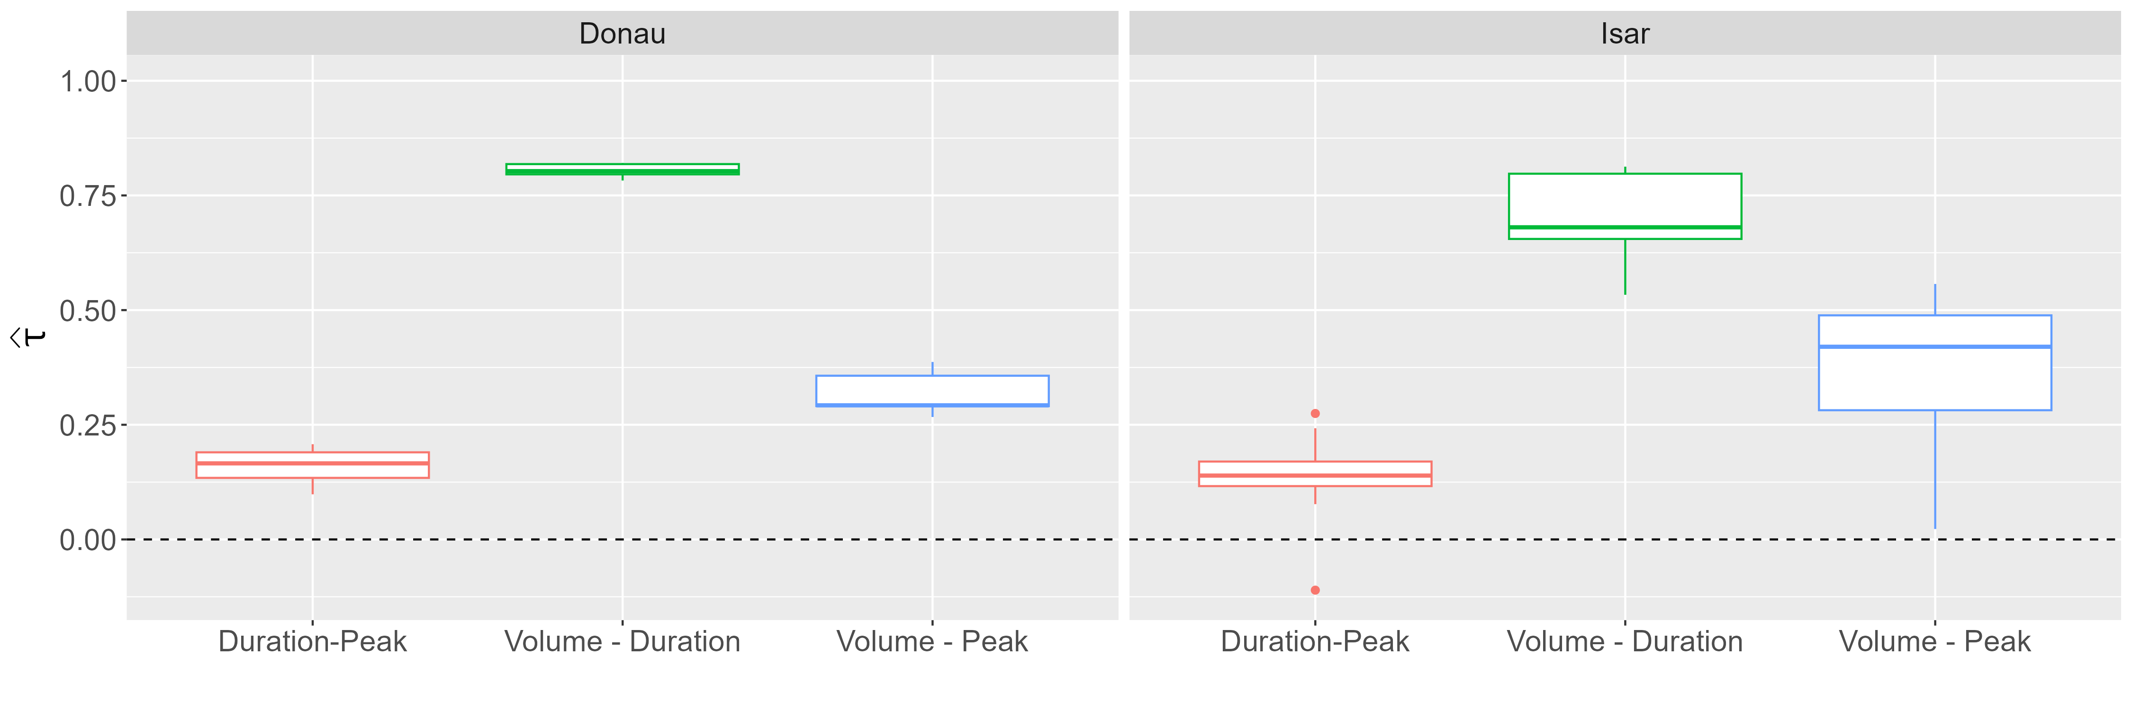
Data
Notes:
Boxplots:
Distribution for all Kendall Correlation Coefficients
Tau higher variation in Isar, one correlation even below 0 (Mittenwald)
Important to note: There seem to be three distinct correlation values / three distrinct strength of dependence (Like already seen for Munich station)
Volume-Duration largest by far, then Volume-Peak, then Duration-Peak. This holds for both rivers
That is, the behavior we saw for the Munich station does also hold for the other stations
This is VERY important because it implies the violation of NACs
Here critizing the paper:
The paper applies NACs without every showing scatterplots or the correlation among the variables. When comparing our analysis to their, we missed those
Thus, we are uncertain if NACs were applicable to the data in the paper?
In our simulation study we will see what happens if NAC applied to vine DGP
>> This brings us to methods part ☺

Slide 12
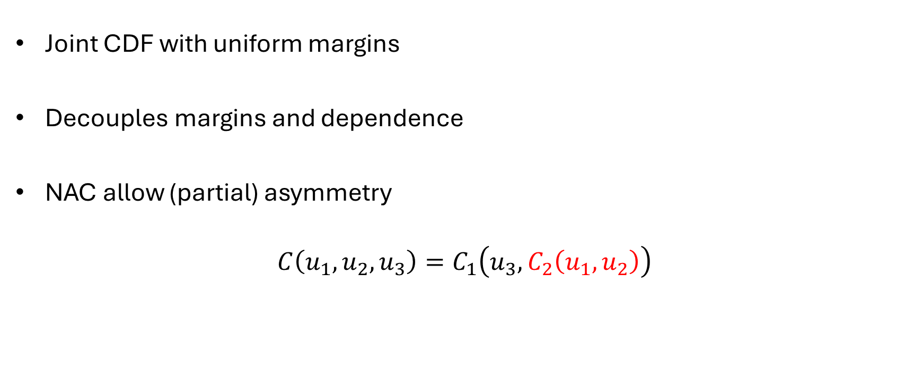
Copula
Joint CDF with uniform margins
Decouples margins and dependence
NAC allow (partial) asymmetry
$$C\left(u_{1},u_{2},u_{3}\right)=C_{1}\left({u_{3},C}_{2}\left(u_{1},u_{2}\right)\right)$$
Notes:
Will not introduce a lot of theory
Keep it intro level friendly
Thus:
Applied NAC example
Basic theory:
Copula is a joint cdf with uniform margins (more on that later. For now think of it as just a function)
Allows to decouple marginal distribution and dependence strucutre
NAC special AC that allow partial asymmetry FORMULA
CDF:
- Function that gives probability X<= x

Slide 13
Appendix

Slide 14
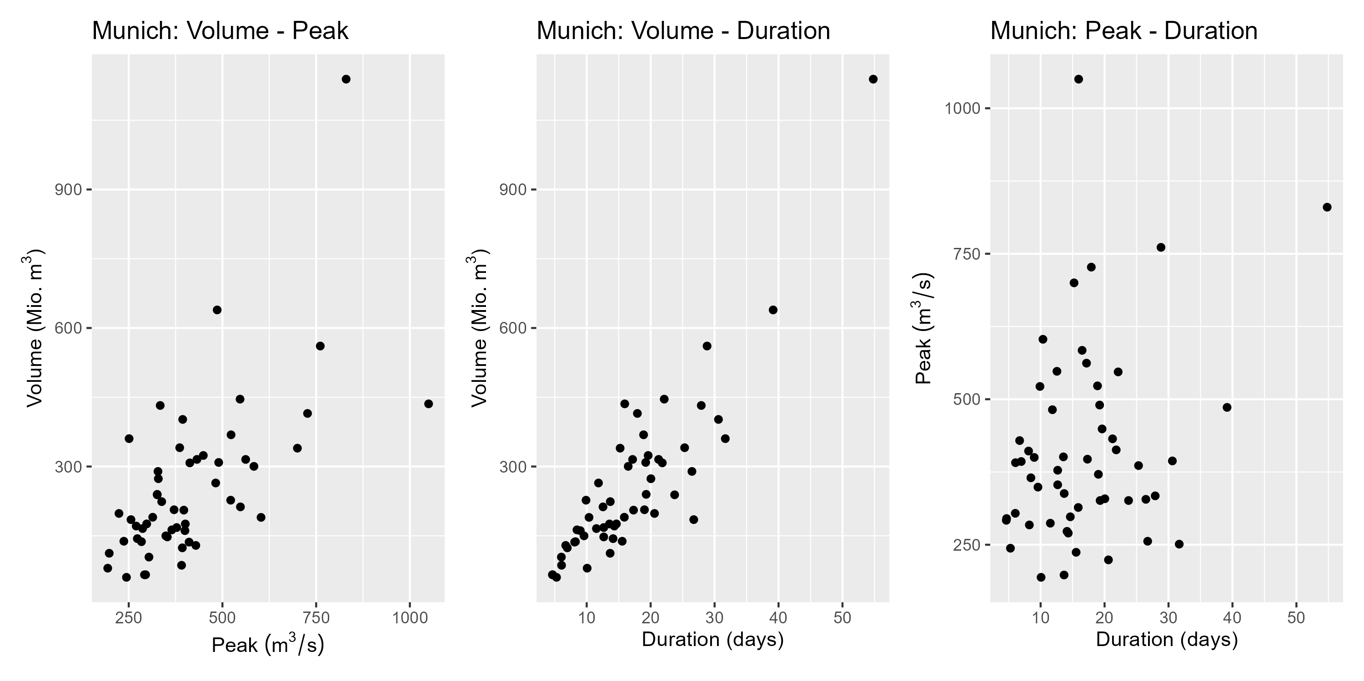
Appendix

Slide 15
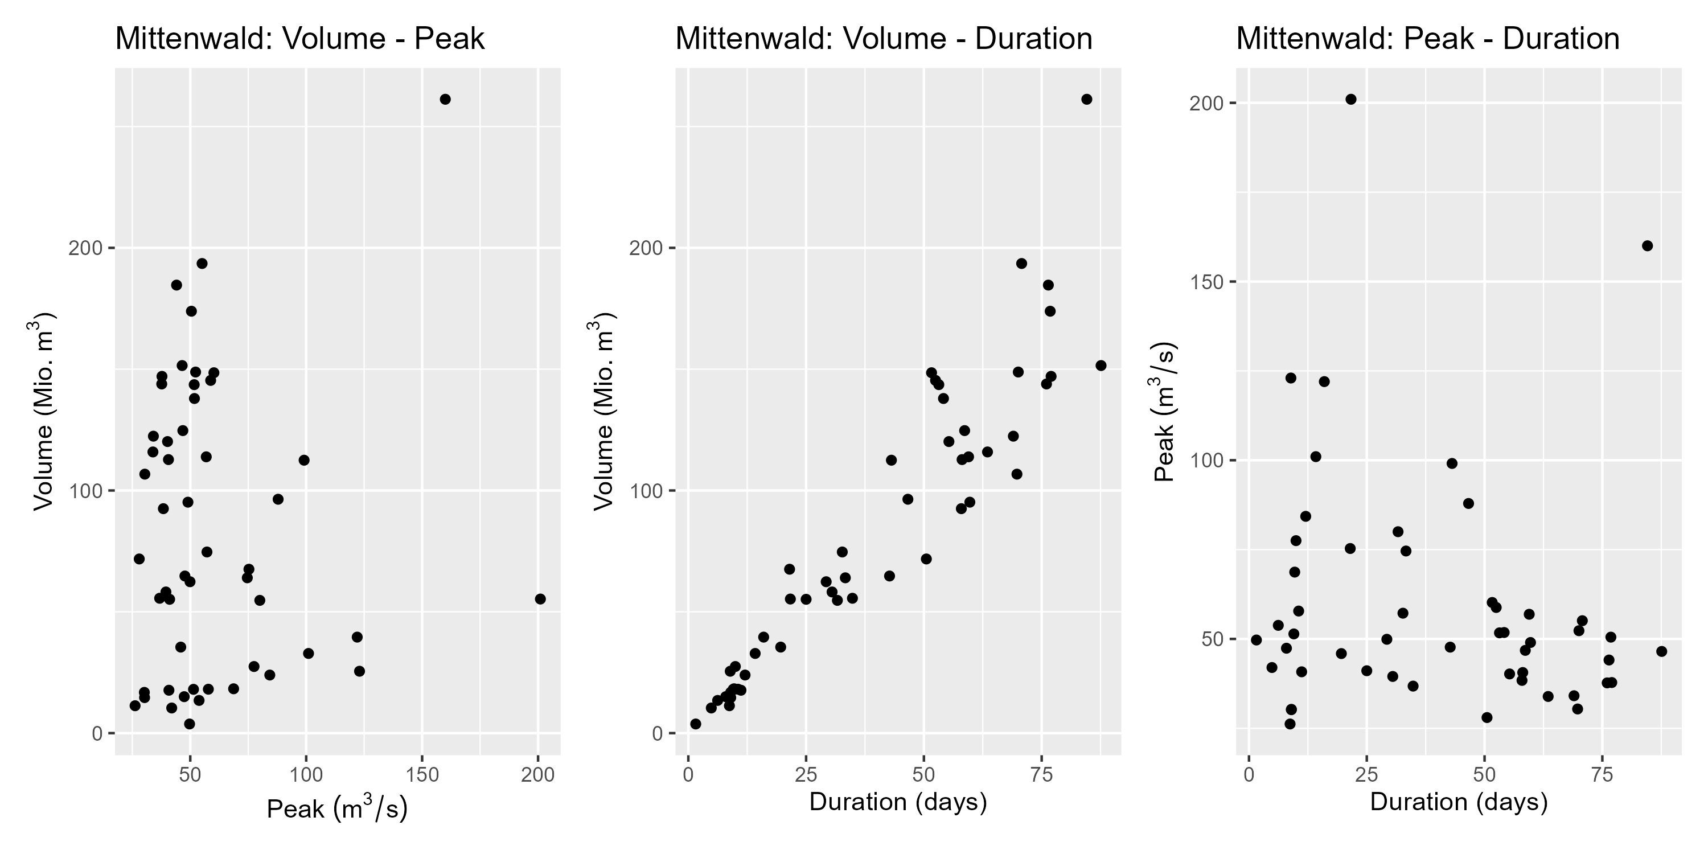
Appendix
Notes:
Negative correlation for duration-peak

